Slide 1






Mentorness Internship Program
Pizza Sales Analysis using SQL

Slide 2

Project overview
The main aim of this project is to analyze pizza sales to gain insights into customer behaviour, popular pizza types, sales trends and overall performance.
The analysis will be performed using four tables:
order_details, orders, pizza_types and pizzas.

Slide 3

Dataset:
order_details
order_details_id: Unique identifier for the order detail.
order_id: Identifier linking to the orders table.
pizza_id: Identifier linking to the pizza table.
quantity: Number of pizzas ordered.
orders
order_id: Unique identifier for the order.
date: Date the order was placed.
time: Time the order was placed.

Slide 4

Dataset:
pizza_type
pizza_type_id: Unique identifier for the pizza type.
name: Name of the pizza.
category: Category of the pizza(vegetarian, meat, etc.)
ingredients: List of ingredients used in the pizza.
pizzas
pizza_id: Unique identifier for the pizza.
pizza_type_id: Identifier linking to the pizza_type table.
size: Size of the pizza (e.g., small, medium, large). price: Price of the pizza.

Slide 5


QUERIES

Slide 6
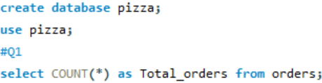

Question 1
The total number of orders placed.
Query:
Output:

Slide 7


Question 2
The total revenue generated from pizza sales
Query:
Output:

Slide 8
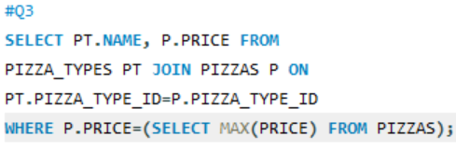

Question 3
The highest priced pizza.
Query:
Output:

Slide 9
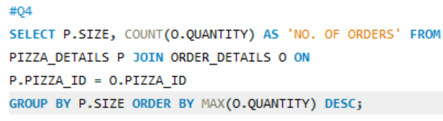
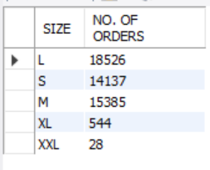
Question 4
The most common pizza size ordered.
Query:
Output:

Slide 10
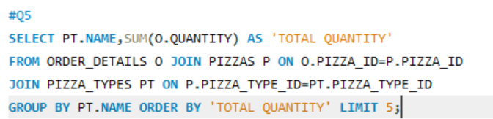
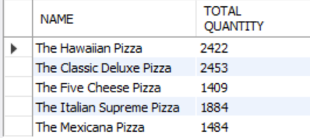
Question 5
The top 5 most ordered pizza types along their quantities.
Query:
Output:

Slide 11
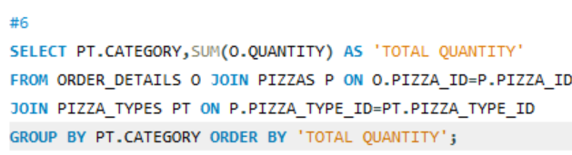
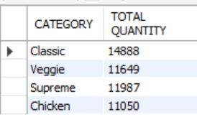
Question 6
The quantity of each pizza categories ordered.
Query:
Output:

Slide 12
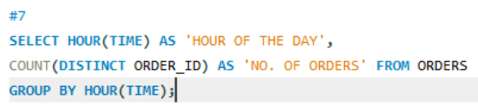
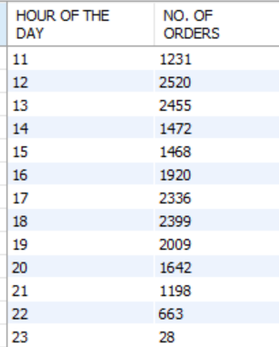
Question 7
The distribution of orders by hours of the day.
Query:
Output:

Slide 13

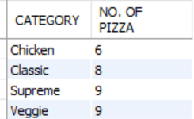
Question 8
The category-wise distribution of pizzas.
Query:
Output:

Slide 14
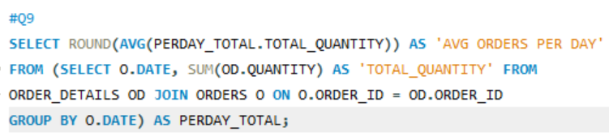

Question 9
The average number of pizzas ordered per day.
Query:
Output:

Slide 15
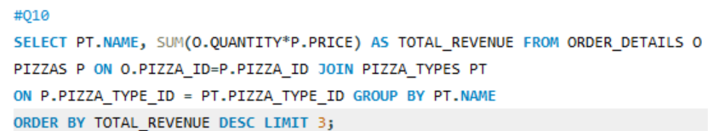
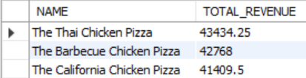
Question 10
Top 3 most ordered pizza type based on revenue.
Query:
Output:

Slide 16
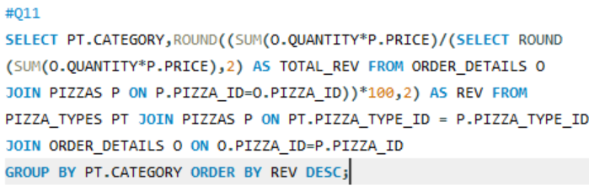
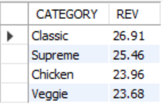
Question 11
The percentage contribution of each pizza type to revenue.
Query:
Output:

Slide 17
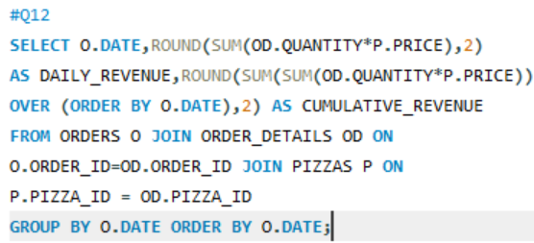
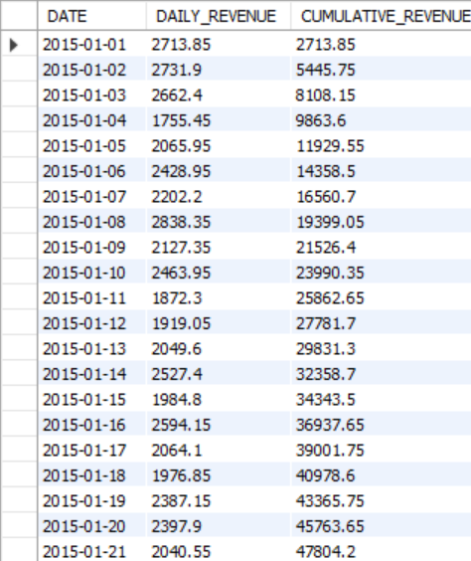
Question 12
The cumulative revenue generated over time.
Query:
Output:

Slide 18
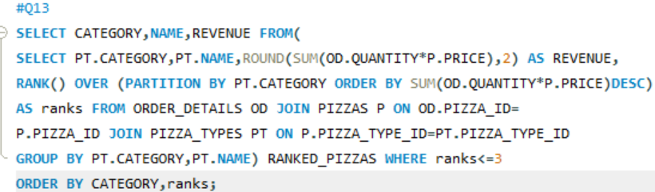
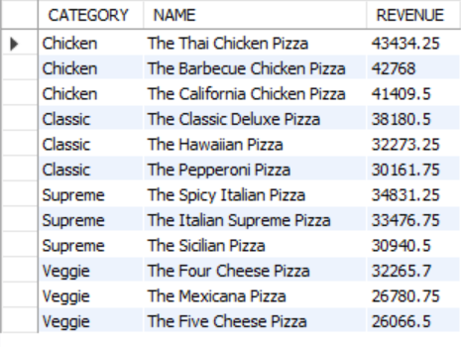
Question 13
The top 3 most ordered pizza type based on revenue for each pizza category.
Query:
Output:

Slide 19



Conclusion
Through the sales analysis we explored various aspects of pizza orders, including customer preferences, overall sales trend, product and cumulative renvenue insights.
Based on these insights the pizza store can make informed decisions to enhance customer experience, drive sales and hence achieve sustained growth.

Slide 20
Thank you!
-Basvi Chunara

